Slide 1
Secure digital identity and vaccine passport management ---Group 3

Slide 2
Introduction
1
(background&project idea)

Slide 3
Background
Our project developed a system that is able to record
people’s vaccination history and is able to help institutes and organizations to tell it the people is qualified
to entrance the countries or regions. The system being proposed is based on the advantages of blockchain
technology, as well as creating a decentralized, mobile, and cross-platform application for its use, as well as a system of incentives and a personalized cryptocurrency to reward users who use it.

Slide 4
Project idea
Firstly, we aims at reducing privacy invasion and prevent discrimination against those non-vaccinated.
Secondly,we are to ensure the security of vaccination passports and prevent tampering and
counterfeiting.Thirdly, our vaccine passport update digital identity timely and gain regional recognition.Last
but not least, our system are designed to be easy to use for everybody and the information safety is also
g

Slide 5
Design Patterns
2

Slide 6
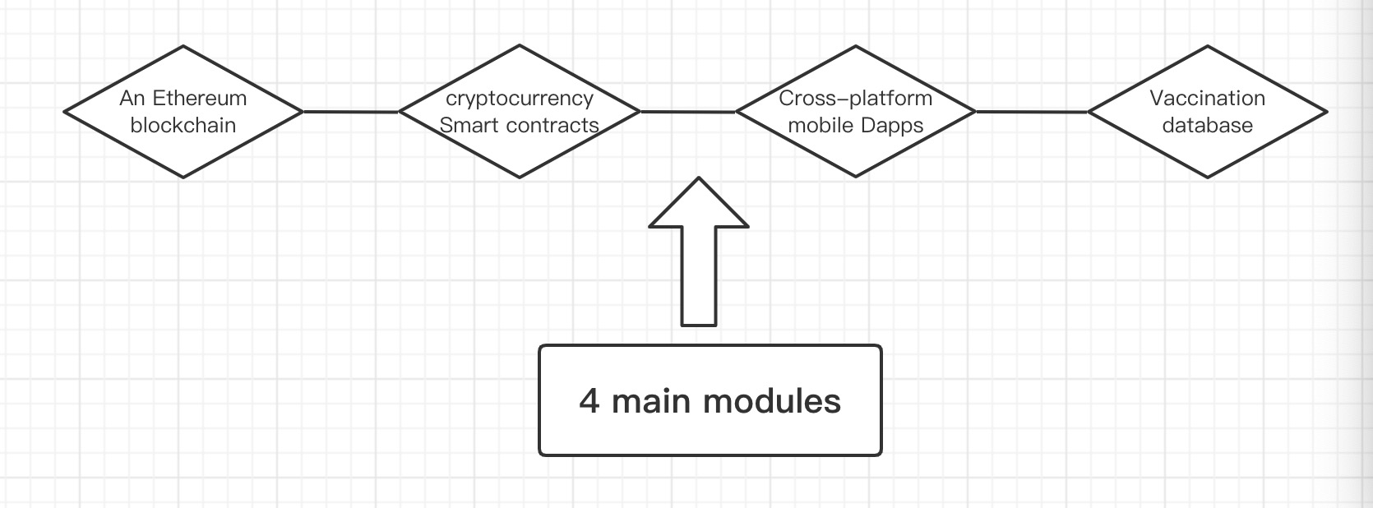
Design Patterns
4 Main modules

Slide 7
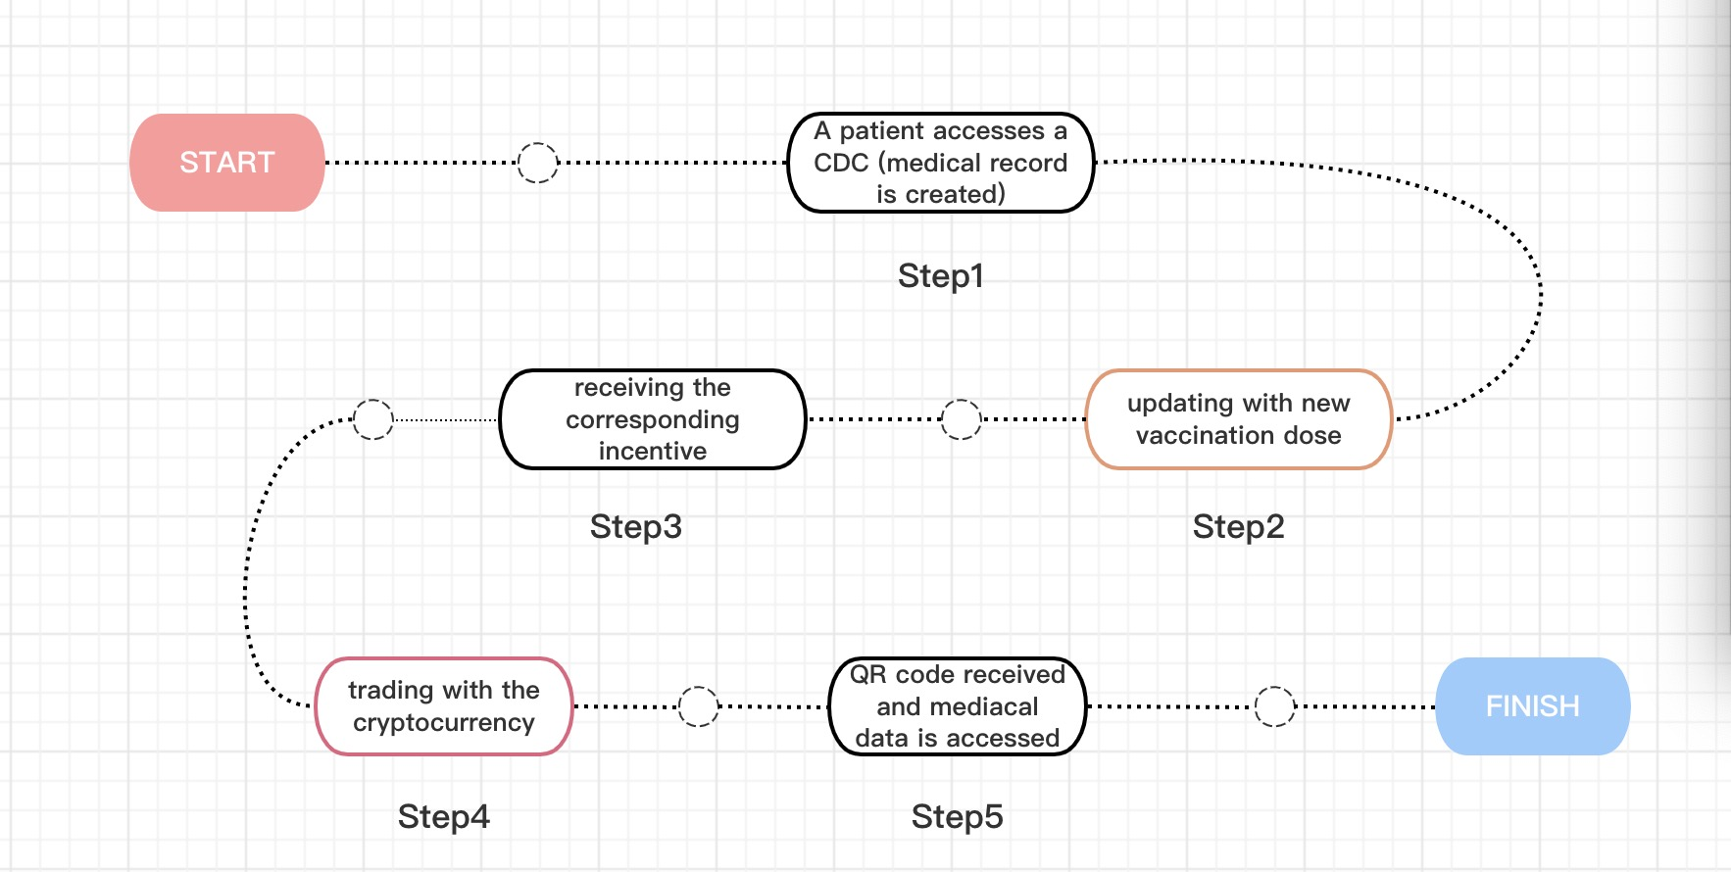
Usage process

Slide 8
DApp Development
3.1

Slide 9
Design Patterns
Front end
Interact
Smart Contract
Software test and Deployment

Slide 10
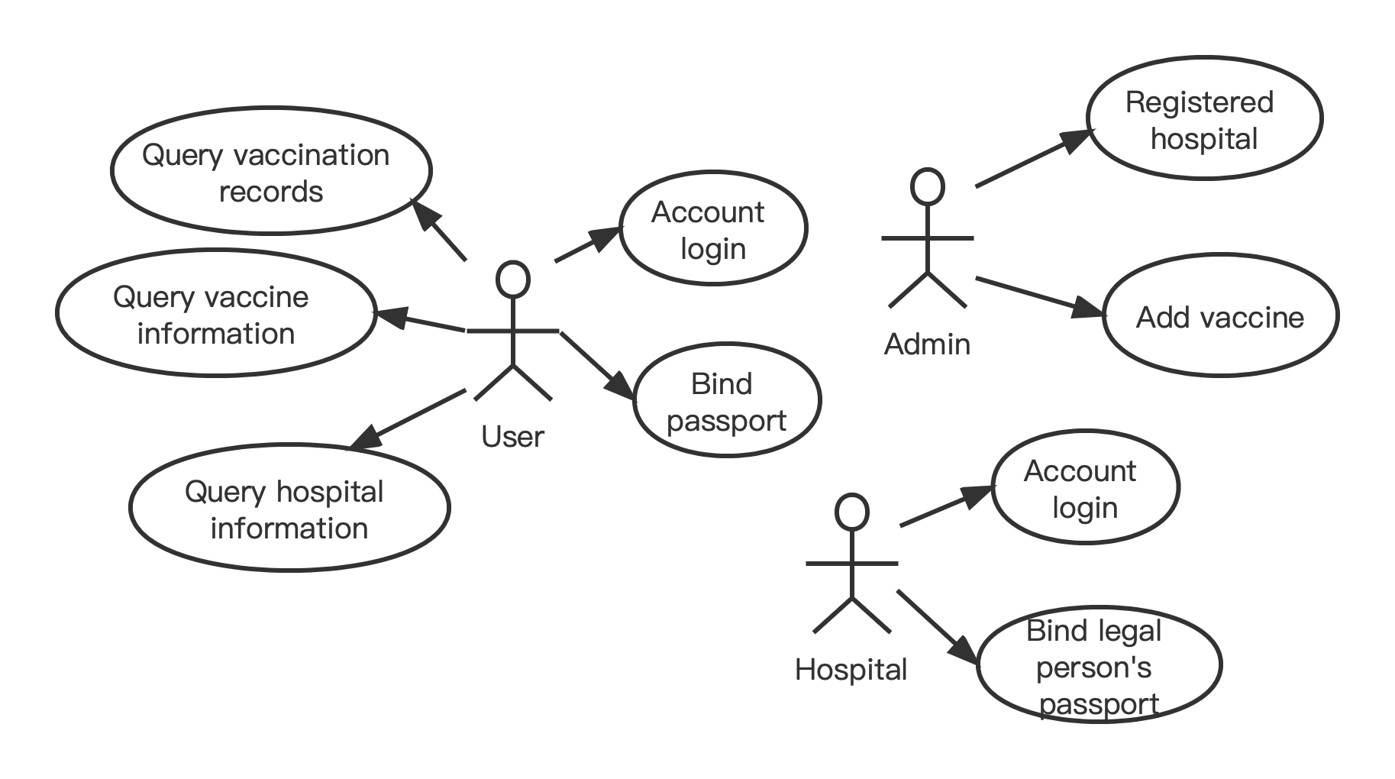
Design Patterns
Use Case

Slide 11
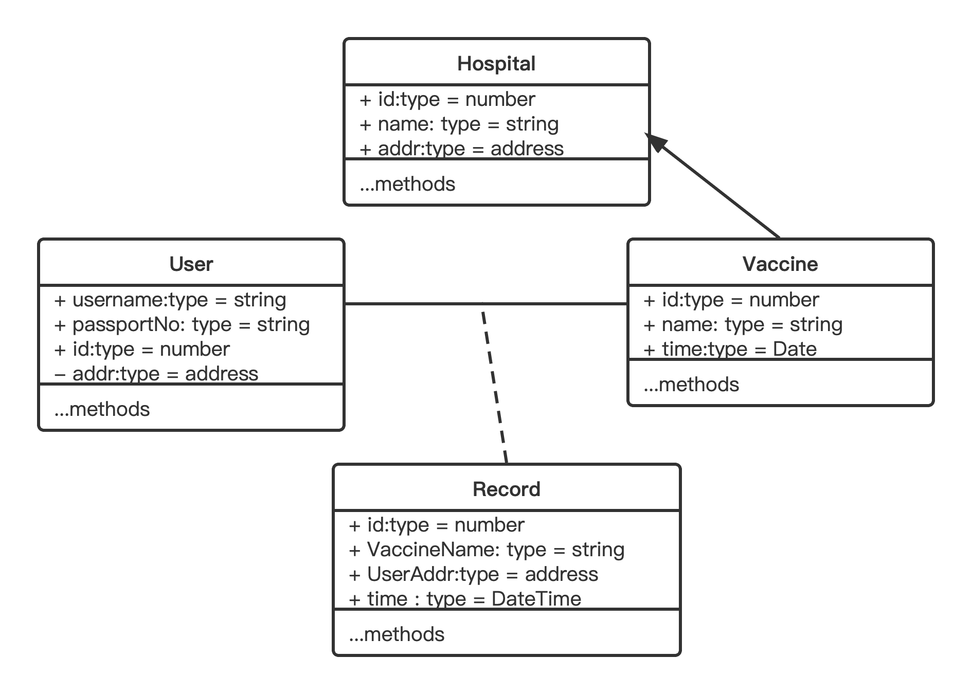
Design Patterns
Class Diagram

Slide 12
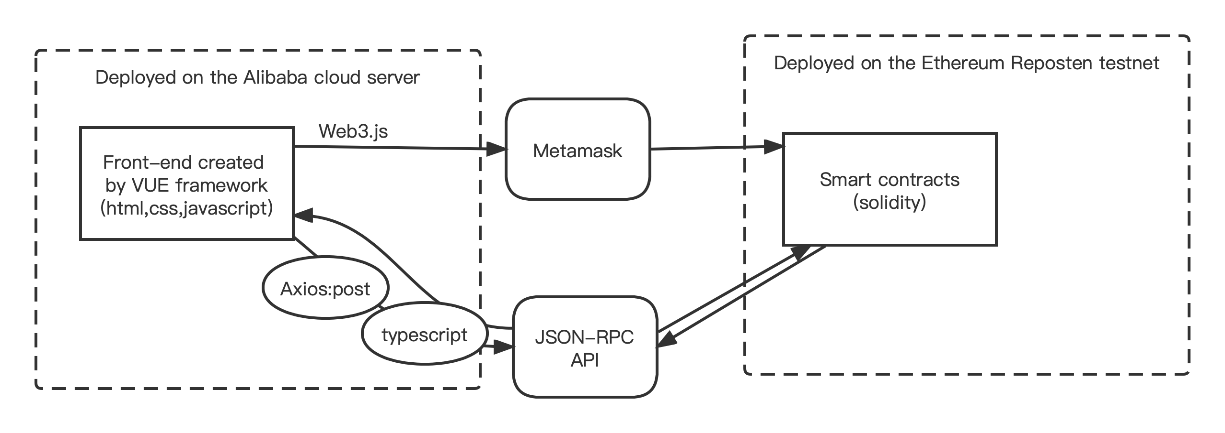
Design Patterns
Technology stack
The above picture shows the main working principle of the application, which is a complete application from client to server, with complete design and function implementation.

Slide 13
Design Patterns
Front end
Interact
Smart Contract
Software test and Deployment

Slide 14
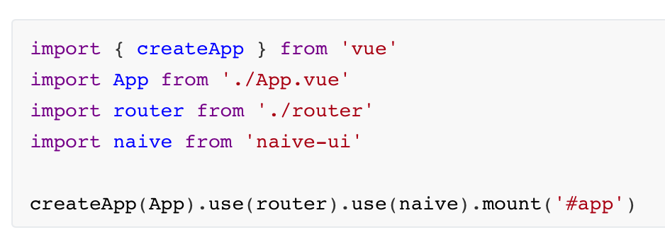
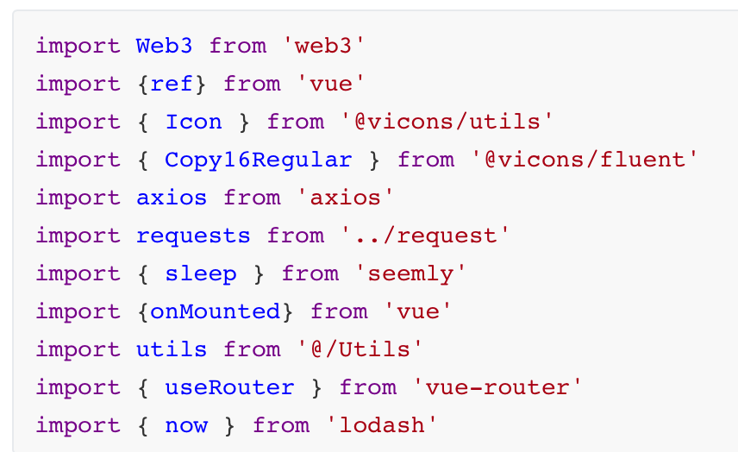
import modules
main.ts Introduces naive-UI components to help rapid prototyping of our applications.

Slide 15
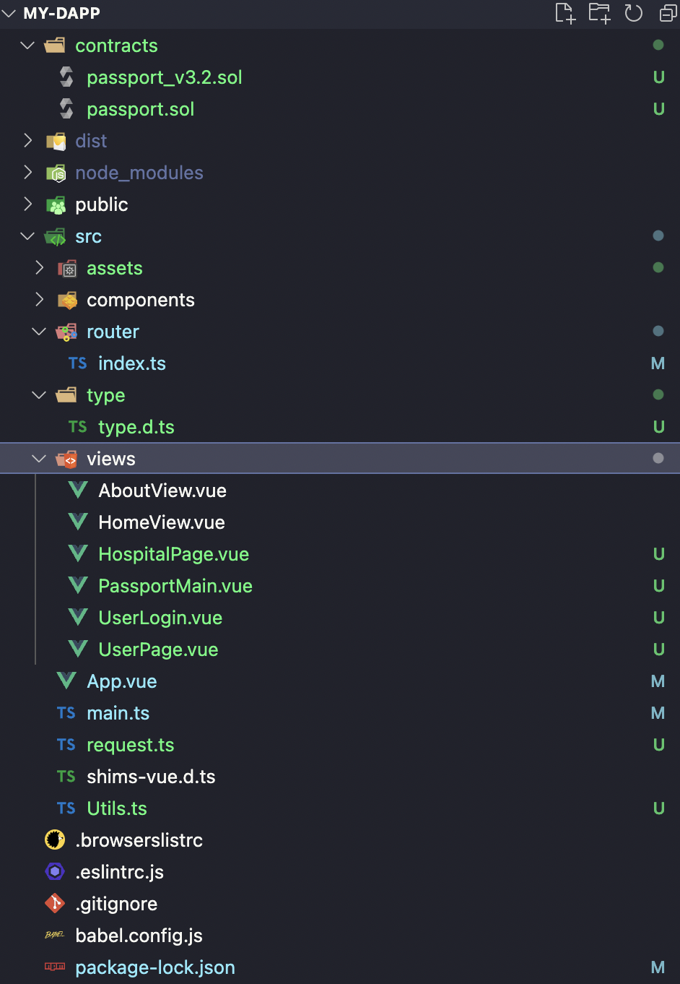
File Tree

Slide 16
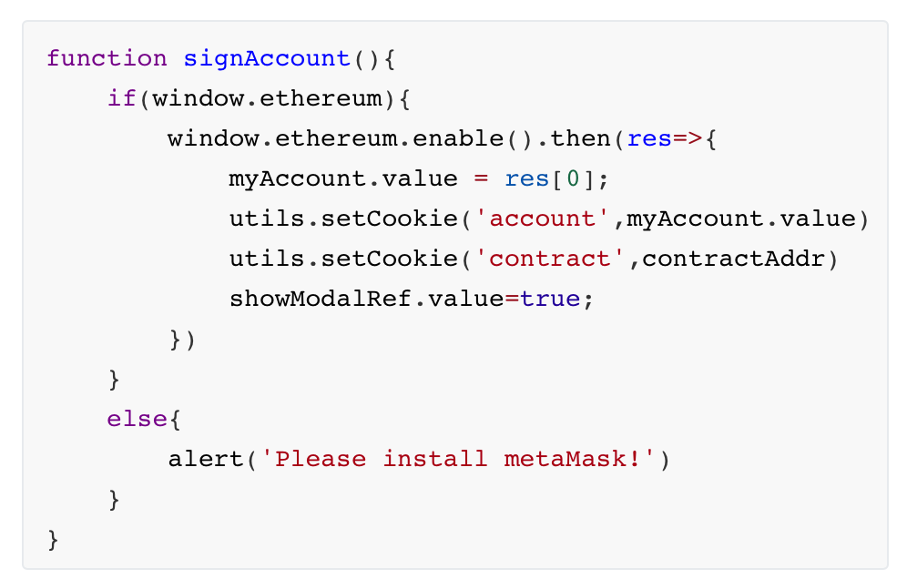
Main functions of user client
When a user logs in, a metamask client needs to be connected to connect to the user's Ethereum account. After the connection is successful, save the relevant information and go to the next step.

Slide 17
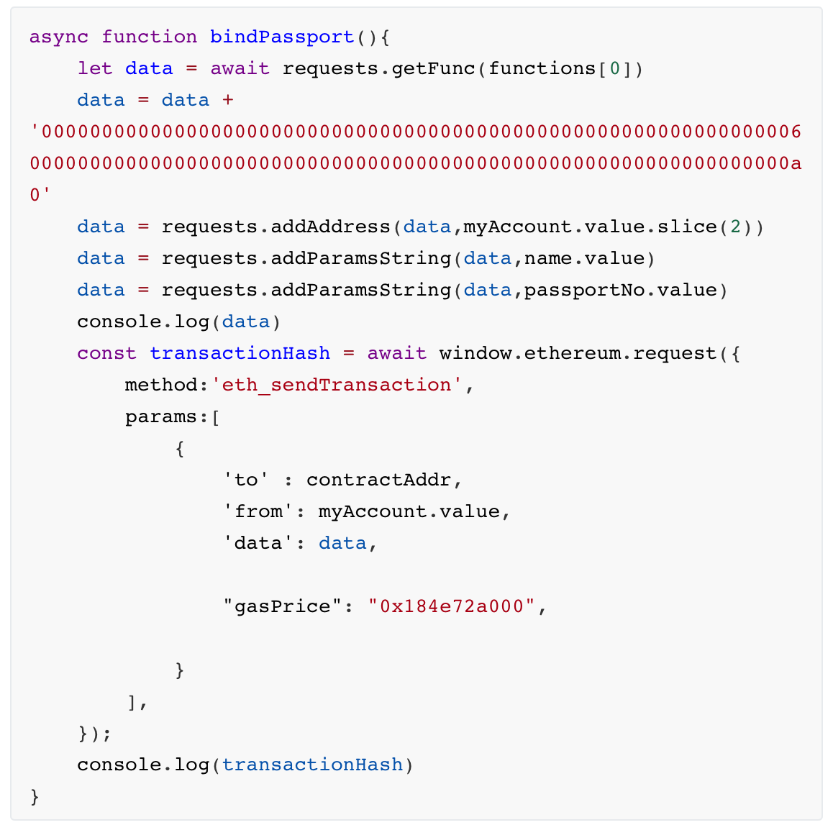
Main functions of user client
In order to be able to uniquely bind the user's Ethereum account address to the user, the user needs to operate and bind their real passport. To confirm identity when performing operations such as vaccination records. Binding a passport requires writing data to the blockchain, so use window.ethereum.request to call metamask to initiate a transaction.

Slide 18
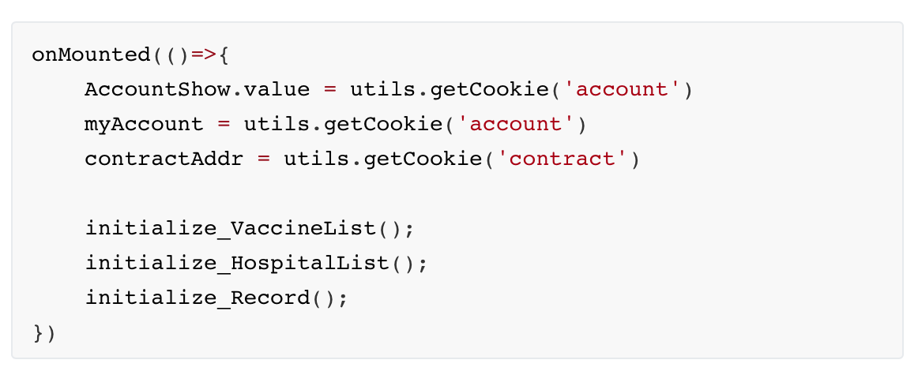
Main functions of user client
When the user client interface is rendered, the current account address and global contract address saved during login are obtained from the cookie：

Slide 19
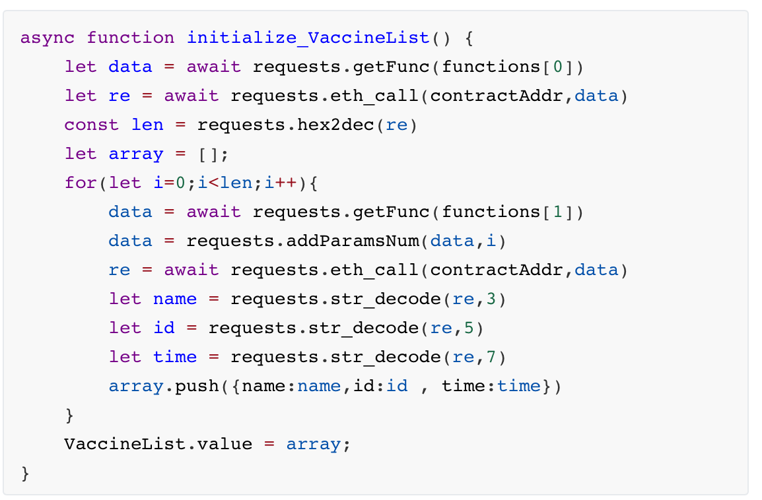
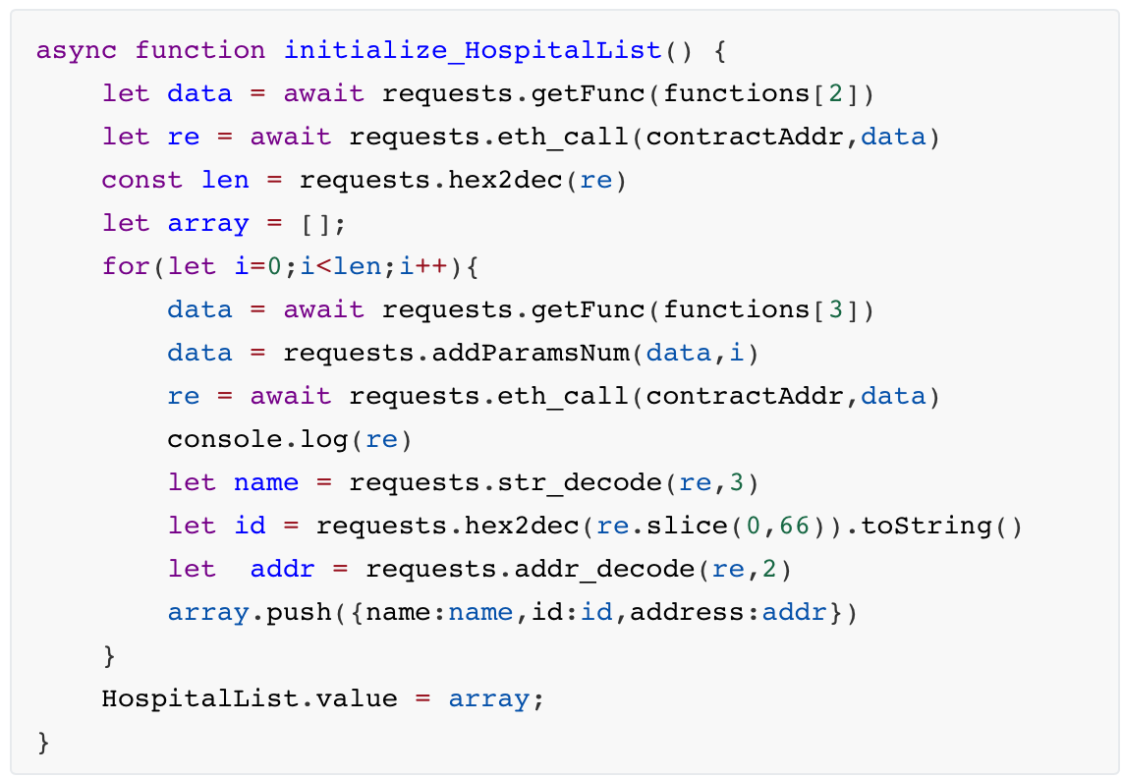
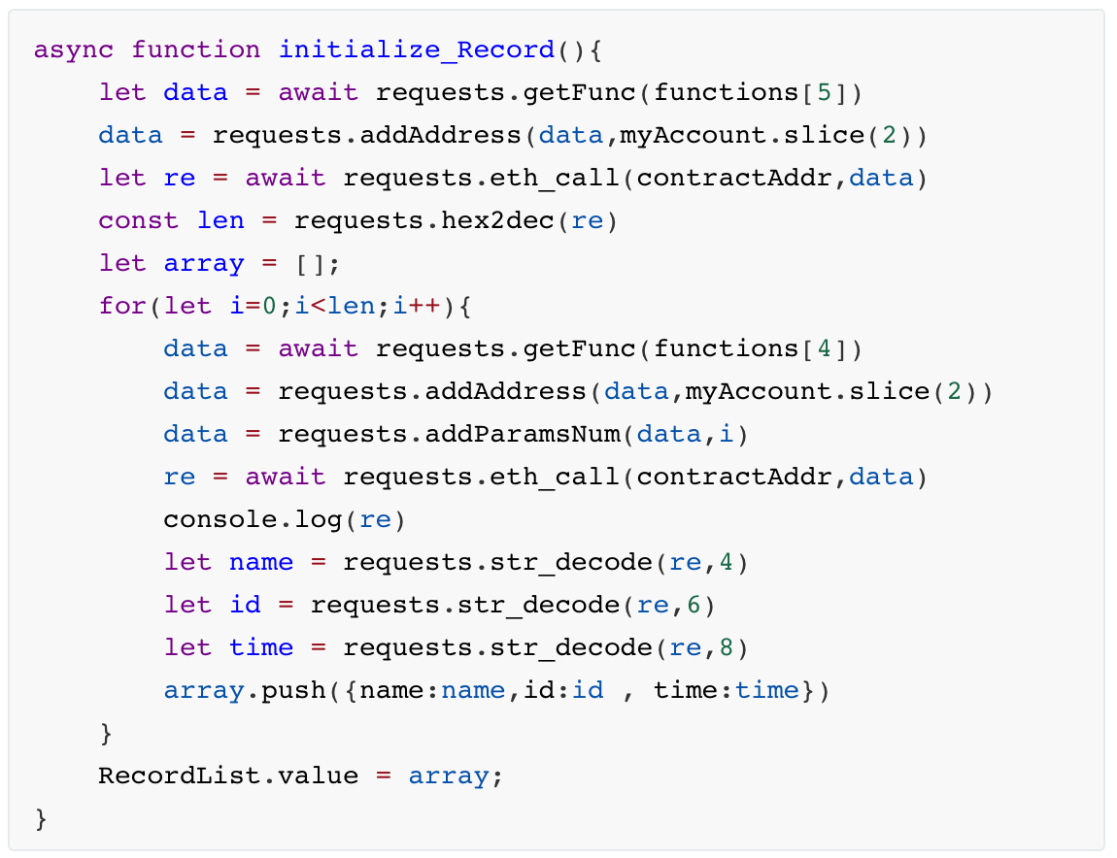
Main functions of user client
The user client has the function of querying its own vaccination records, querying all vaccine information, and hospital information. So the data corresponds to three lists.

Slide 20
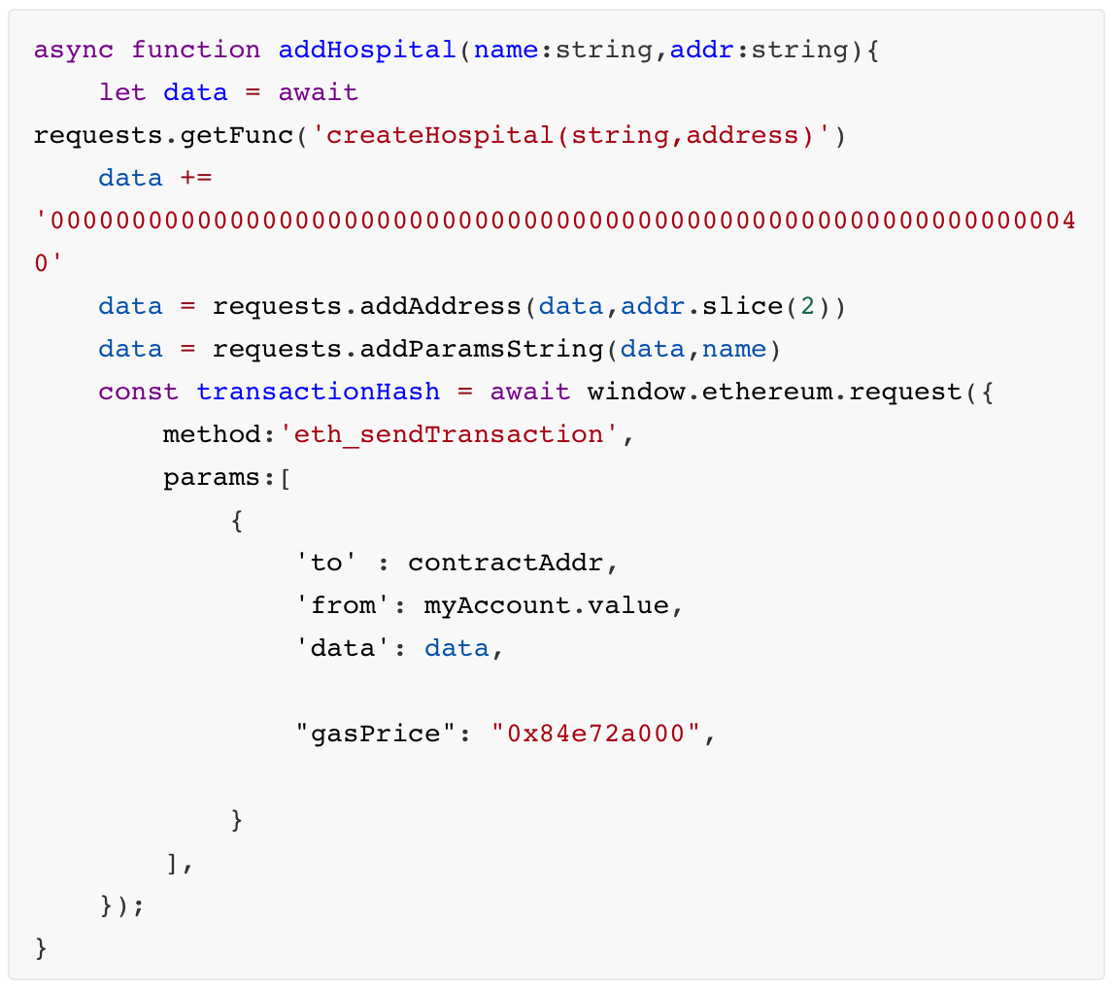
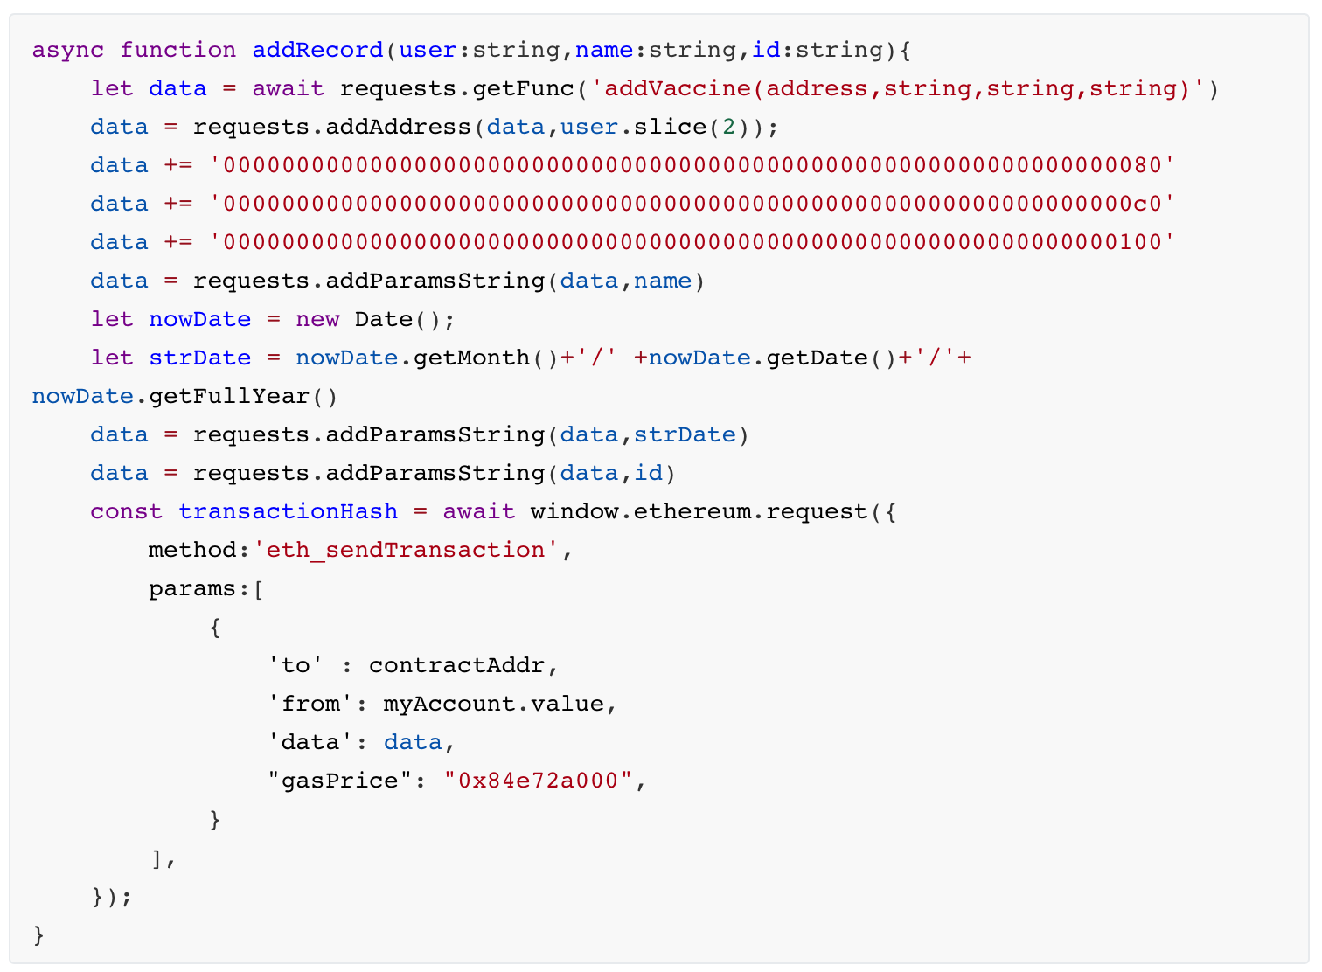
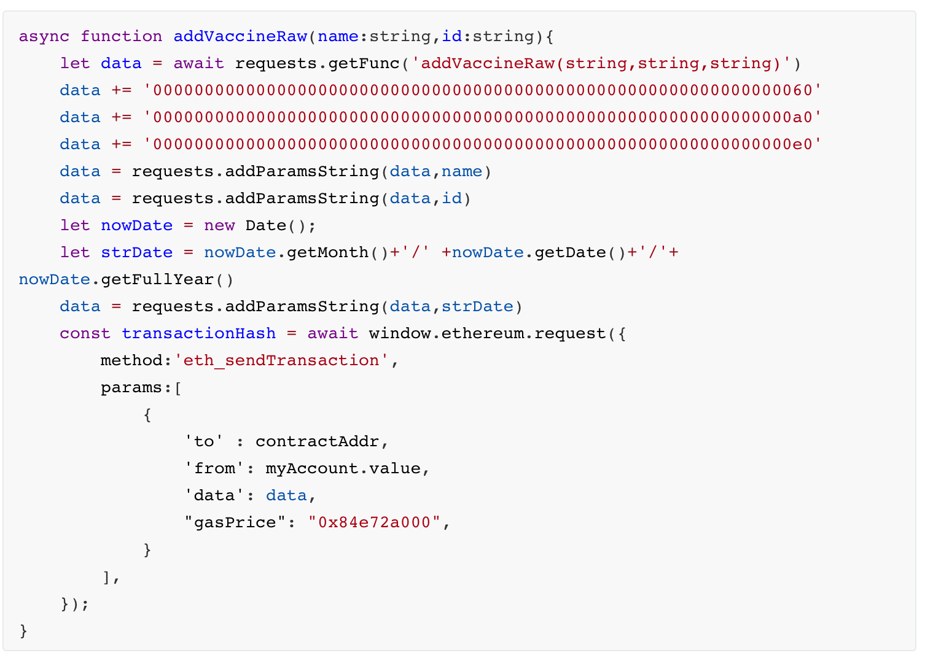
Main functions of hospital client
The hospital client has three main functions, namely hospital registration, adding vaccine information for users, and adding new vaccines.
The three main functions of the hospital client all need to write data into the blockchain, so they all need to call metamask to initiate a transaction, and the initiator bears the corresponding gas fee.

Slide 21
Design Patterns
Front end
Interact
Smart Contract
Software test and Deployment

Slide 22
Interact
Web3js is a very useful tool for interacting with smart contracts. However, in this application development, after many attempts and explorations, it was impossible to successfully install the application web3js and use the packaged functions. So I chose JSON-RPC API for interacting with smart contracts. In the interaction, we also encountered and solved many problems. For example, there is no clear and clear guidance for the parsing and coding of the data field in the API, and the intelligence can write the correct function through its own exploration and regular search.

Slide 23
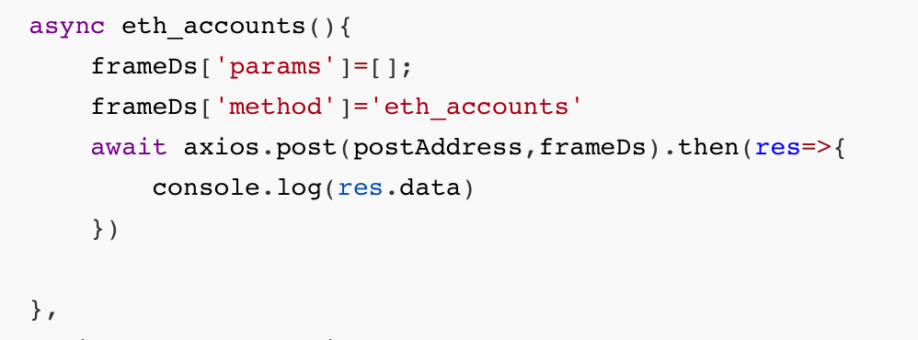
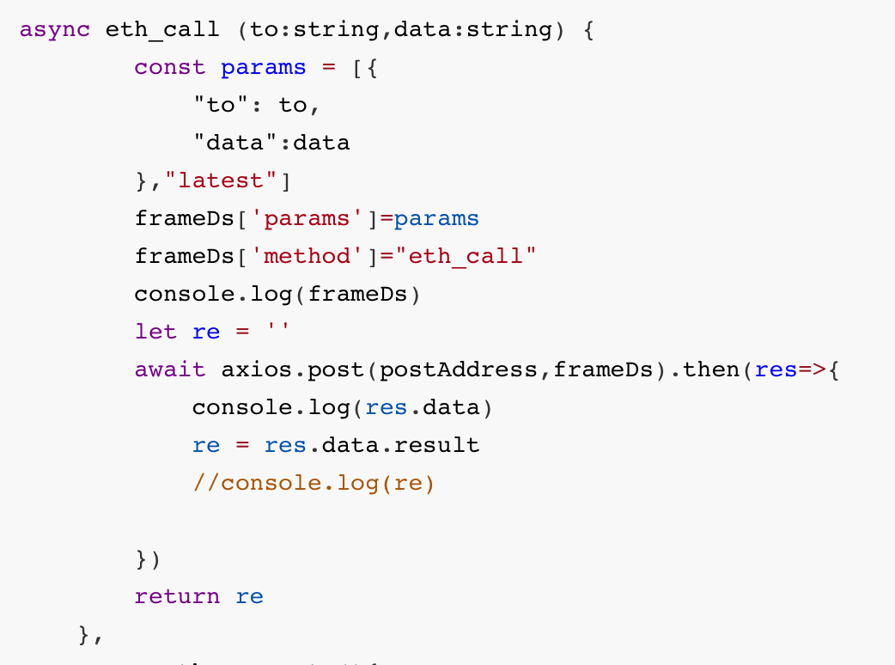
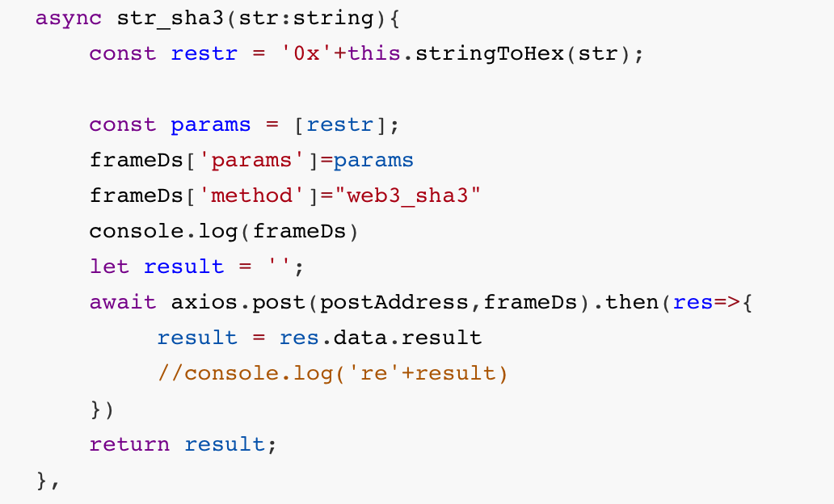
Application Development - Interact
In order to facilitate the various modules of the application to call related interactive functions, I encapsulate the interactive functions and some auxiliary functions in a .ts file: requests.ts, some of the functions as follow :

Slide 24
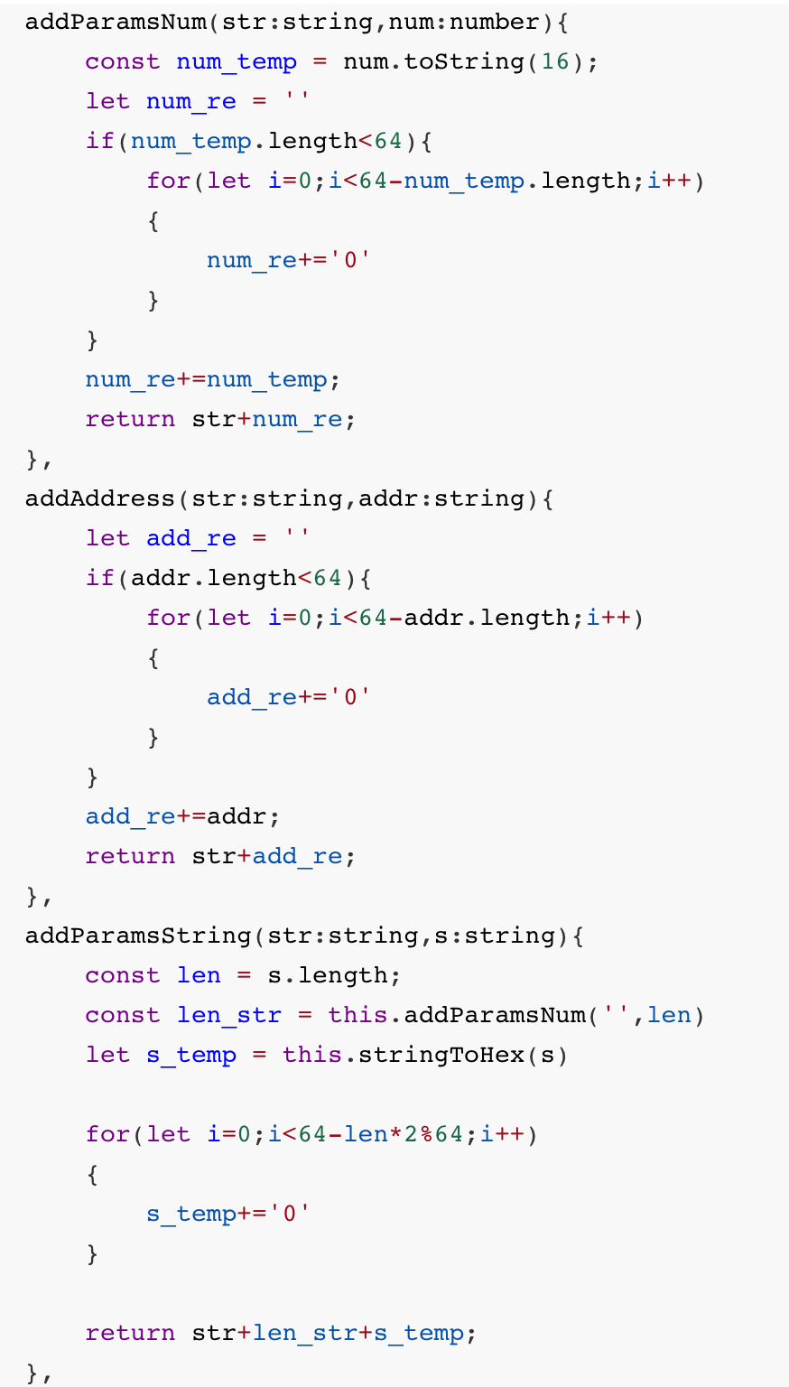
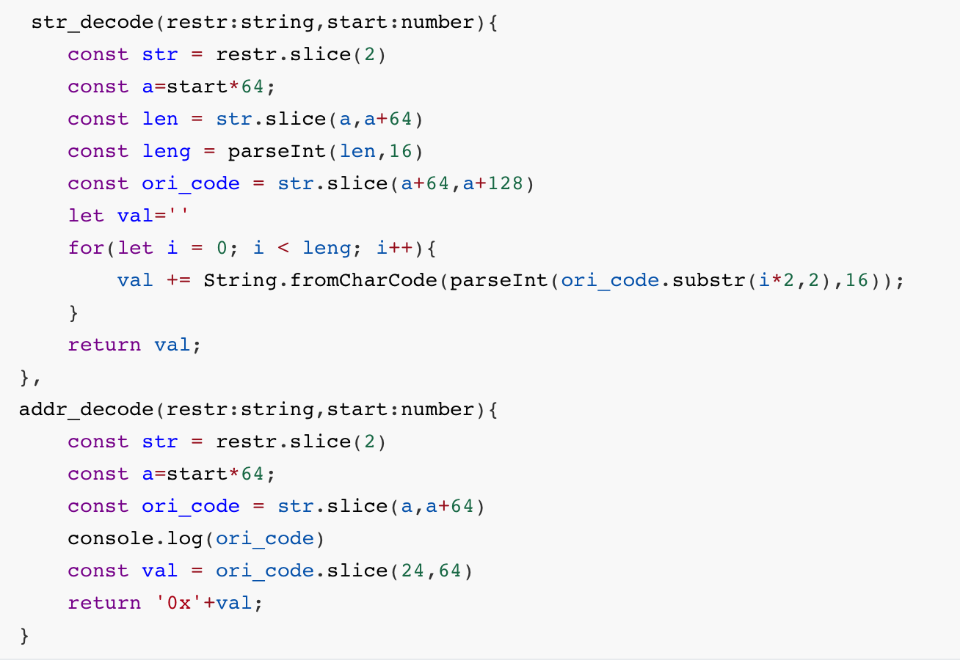
Application Development - Interact
In order to facilitate the various modules of the application to call related interactive functions, I encapsulate the interactive functions and some auxiliary functions in a .ts file: requests.ts, some of the functions as follow :

Slide 25
Design Patterns
Front end
Interact
Smart Contract
Software test and Deployment

Slide 26
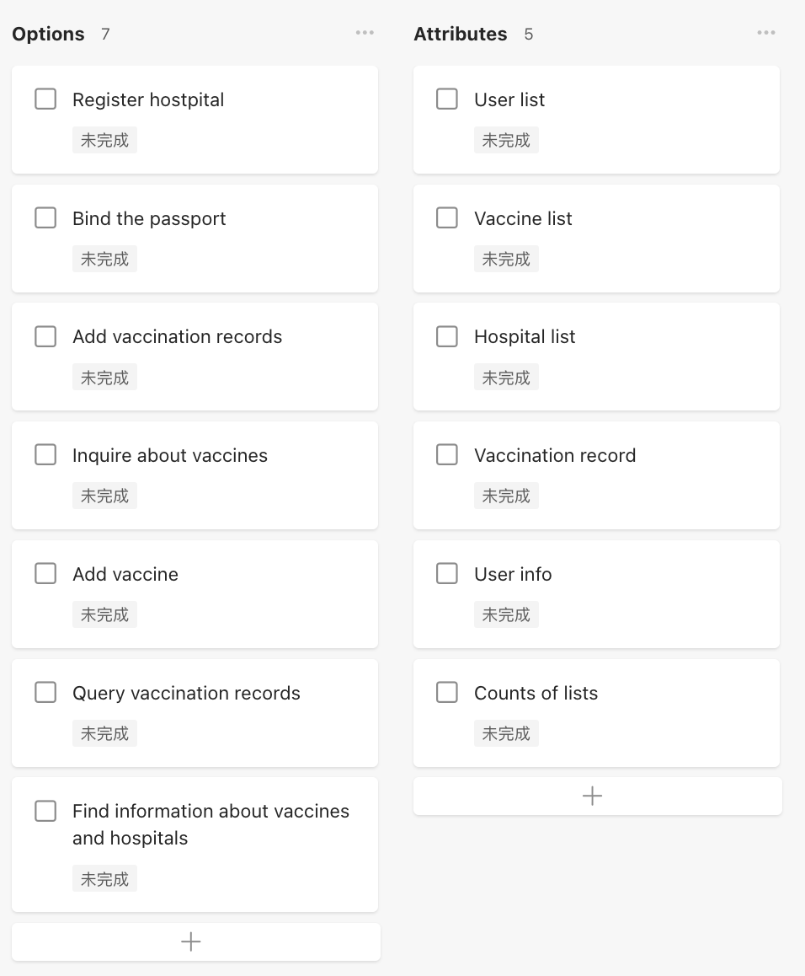
Application Development - Interact
In the design of smart contracts, I use the teambition tool to record the application's requirements for functions and functions, so that our design and writing can be more coherent and logical.

Slide 27
Design Patterns
Front end
Interact
Smart Contract
Software test and Deployment

Slide 28
Software Test
The software testing phase of the application is performed locally. Execute `npm run serve` in the root directory of the front-end file. The application will be run on `localhost:8080`. Fortunately, after many days and nights of tireless work, the features of the app passed the test and all the issues found were fixed, which makes the application ready for deployment.

Slide 29
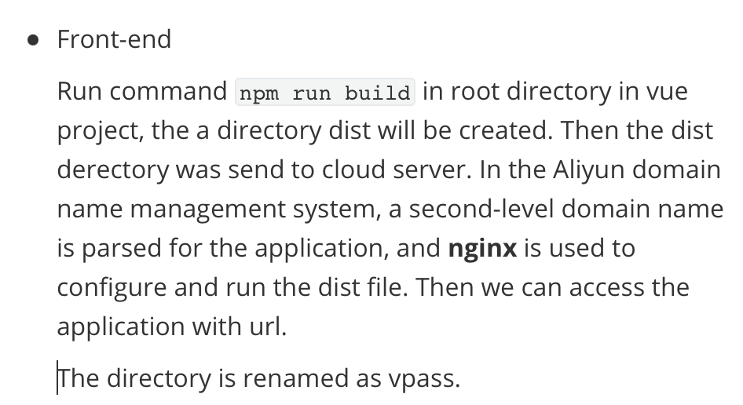
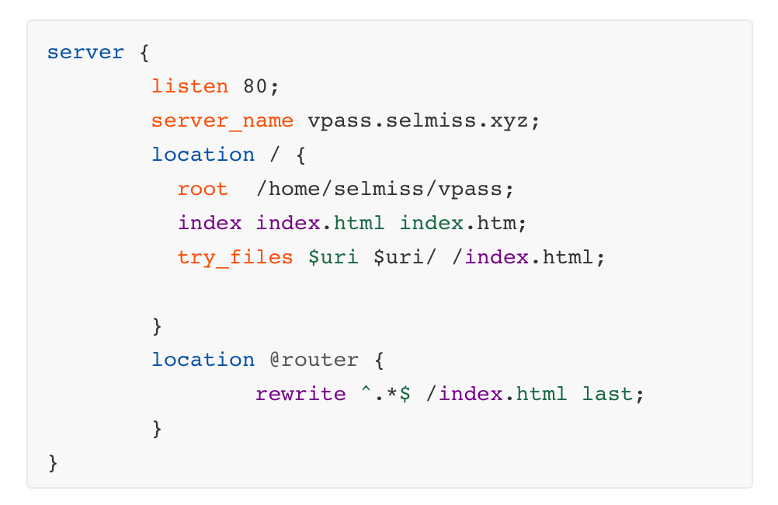
Deployment

Slide 30
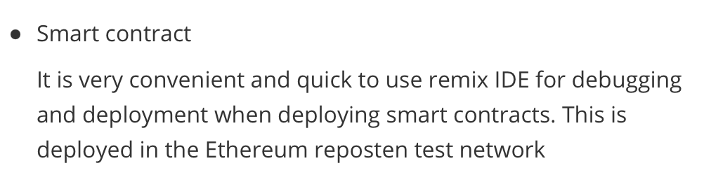
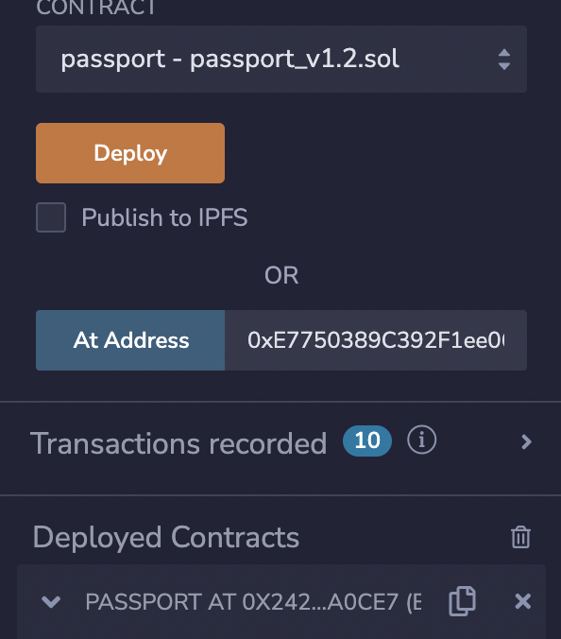
Deployment

Slide 31
Smart Contract Code
3.2

Slide 32
Storage Data
// Vaccine basic information
struct Vaccine {
string name;
string id;
string time;
}
// User basic information
struct User {
uint256 id;
string name;
string passportNo;
address addr;
}
// Hospital basic information
struct Hospital {
uint256 id;
string name;
address addr;
}
//Array of Vaccines
Vaccine[] public vaccines;
Hospital[] public hospitalArray;
// match hospital address with information
mapping (address => Hospital) hospital;
// match user address with information
mapping (address => User) user;
// match user address with its total vaccine count
mapping (address => uint32) vaccineCount;
// match user address with its vaccine
mapping (address => mapping(uint32 => Vaccine)) vaccine;
Struct – create type and store information (User, Hospital and Vaccine)
Mapping and Array – match certain address with its special type

Slide 33
Modifier
Three tiers of authority
Owner – manager, administrator
Hospital – hospitals, CDCs
User – public
modifier onlyOwner() {
require(msg.sender == owner);
_;
}
modifier onlyHospital() {
require(
msg.sender == hospital[msg.sender].addr ||
msg.sender == owner
);
_;
}
modifier onlyUser() {
require(
msg.sender == hospital[msg.sender].addr ||
msg.sender == owner ||
msg.sender == user[msg.sender].addr
);
_;
}

Slide 34
Modify Data (1 of 2)
function createUser(
string memory _name,
string memory _passportNo,
address _user)
public onlyHospital {
require(user[_user].addr != _user);
User memory u = User(
userCount,
_name,
_passportNo,
_user
);
Vaccine memory v = Vaccine("", "", "");
user[_user] = u;
vaccineCount[_user] = 0;
vaccine[_user][vaccineCount[_user]] = v;
userCount++;
}
function createHospital(
string memory _name,
address _hospital)
public onlyOwner{
require(hospital[_hospital].addr != _hospital);
Hospital memory h = Hospital(
hospitalCount,
_name,
_hospital
);
hospital[_hospital] = h;
hospitalArray.push(h);
hospitalCount++;
}
Adding a user
(Only CDCs or administrator)
Adding a CDC or hospital
(Only administrator)

Slide 35
Modify Data (2 of 2)
function addVaccineRaw(
string memory _name,
string memory _id,
string memory _time)
public onlyHospital {
Vaccine memory newVaccine = Vaccine(_name,_id,_time);
vaccines.push(newVaccine);
vaccineCountAll ++;
}
Adding vaccine information
(Only CDCs or administrator)
function addVaccine(
address _user,
string memory _name,
string memory _time,
string memory _id)
public onlyHospital {
require(_user == user[_user].addr);
Vaccine memory v = Vaccine(
_name,
_id,
_time
);
vaccine[_user][vaccineCount[_user]] = v;
vaccineCount[_user] ++;
}
Adding a certain vaccine to user
(Only CDCs or administrator)

Slide 36
Access Data
function getUserInfo(address _user) public onlyUser view returns(User memory userinfo) {
userinfo = user[_user];
}
function getUserVacc(address _user, uint32 _index) public onlyUser view returns(Vaccine memory v) {
uint32 count = vaccineCount[_user];
require(count > 0);
require(_index < count);
v = vaccine[_user][_index];
}
function getHospital(uint32 _index) public onlyUser view returns(Hospital memory v) {
v = hospitalArray[_index];
}
Accessing to its own information
(CDCs, administrator and user)
Accessing to its own vaccine receiving
(CDCs, administrator and user)
Accessing to all of CDCs or hospitals
(CDCs, administrator and user)

Slide 37
Application Usage
4

Slide 38
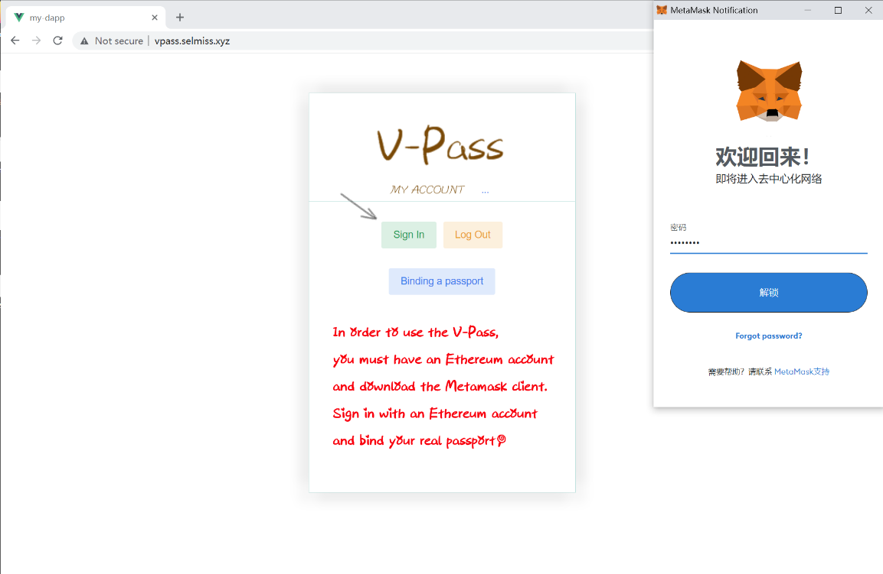
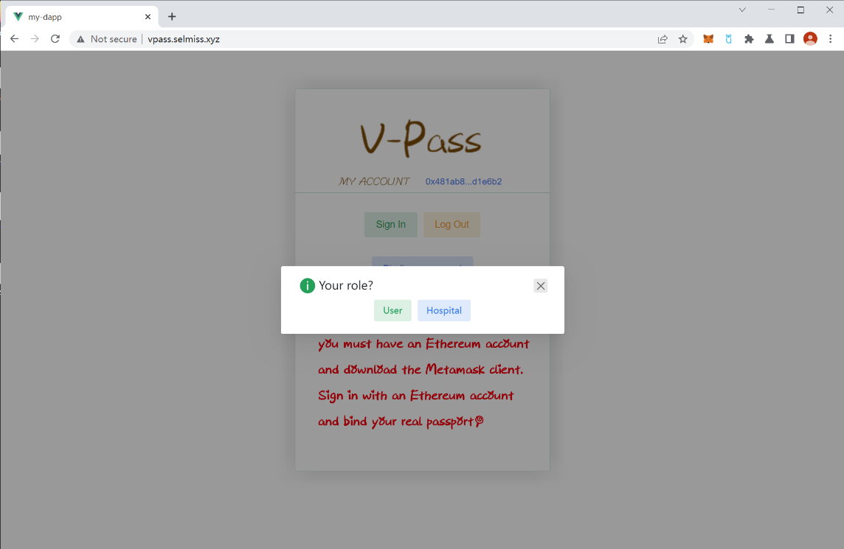
Login
Two Client
User
CDCs

Slide 39
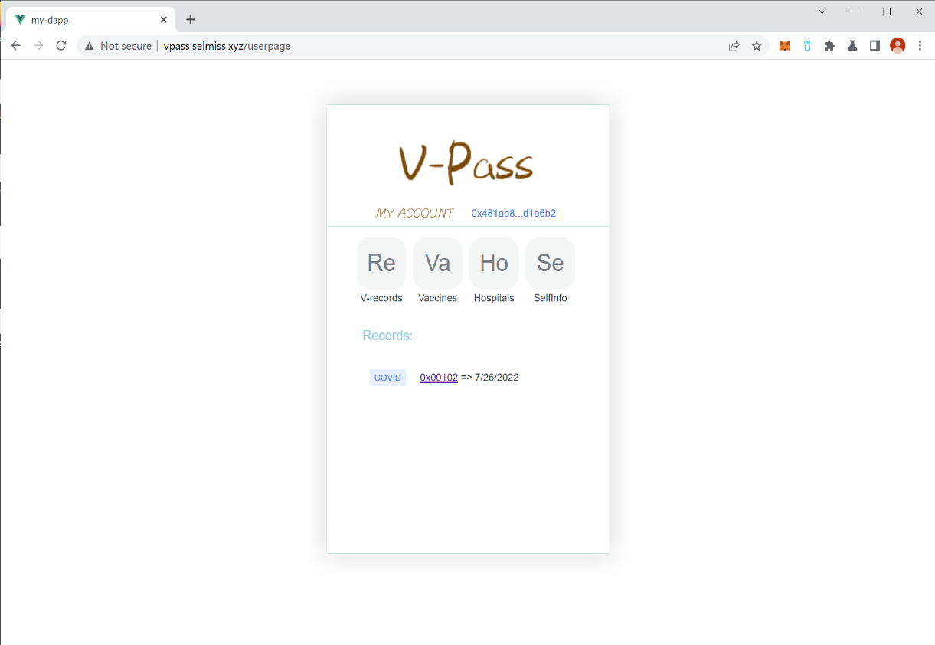
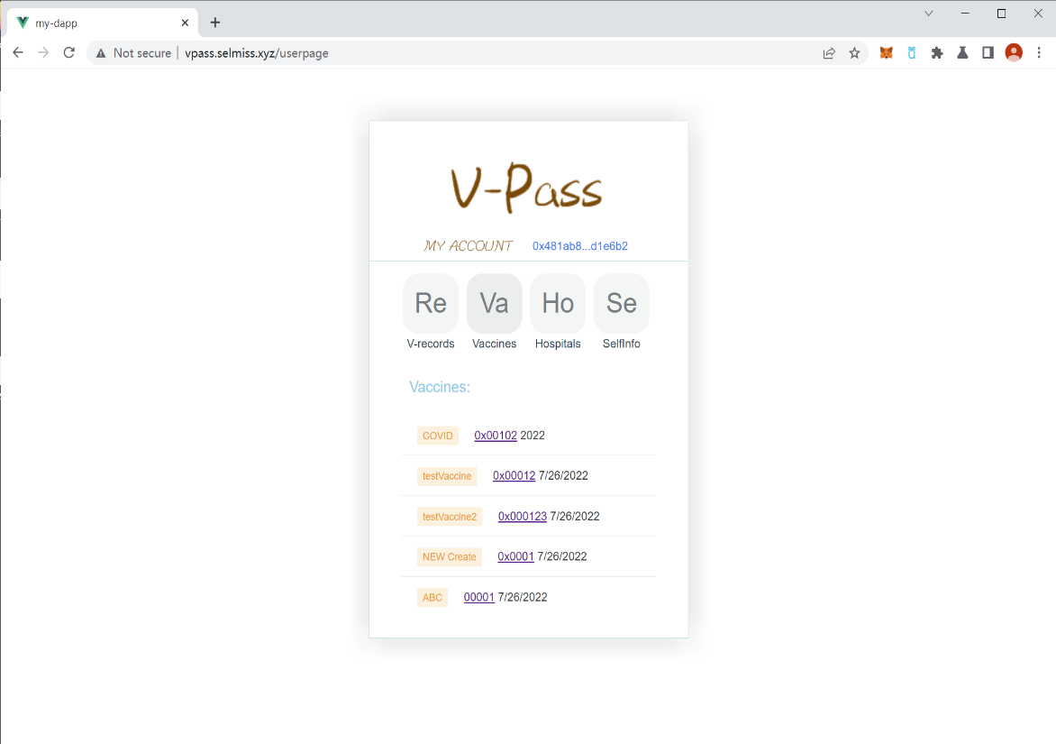
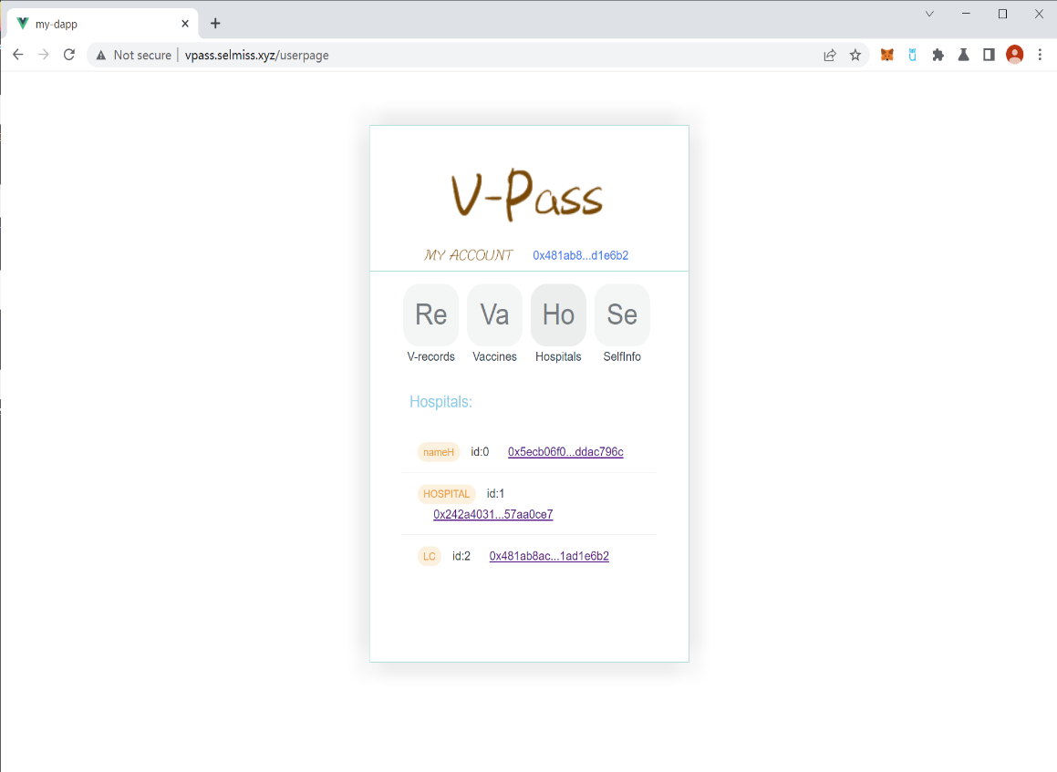
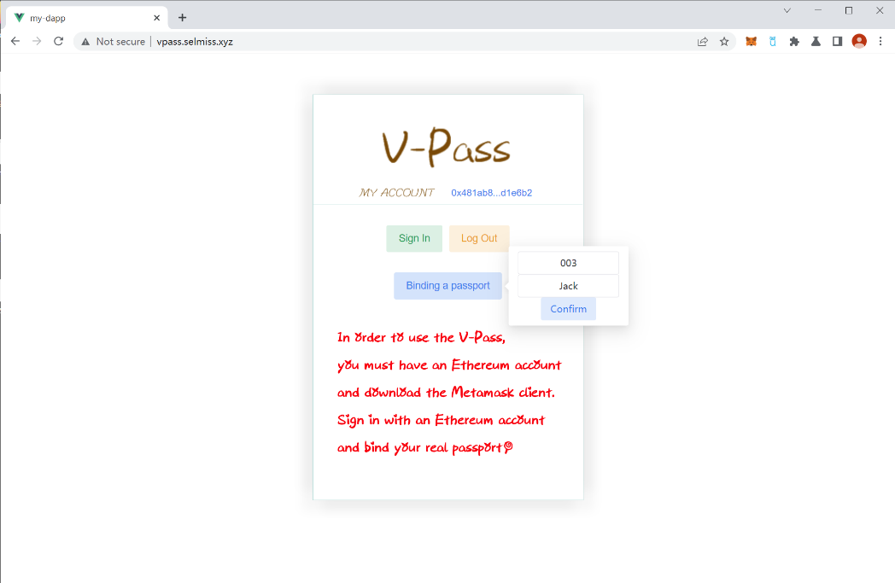
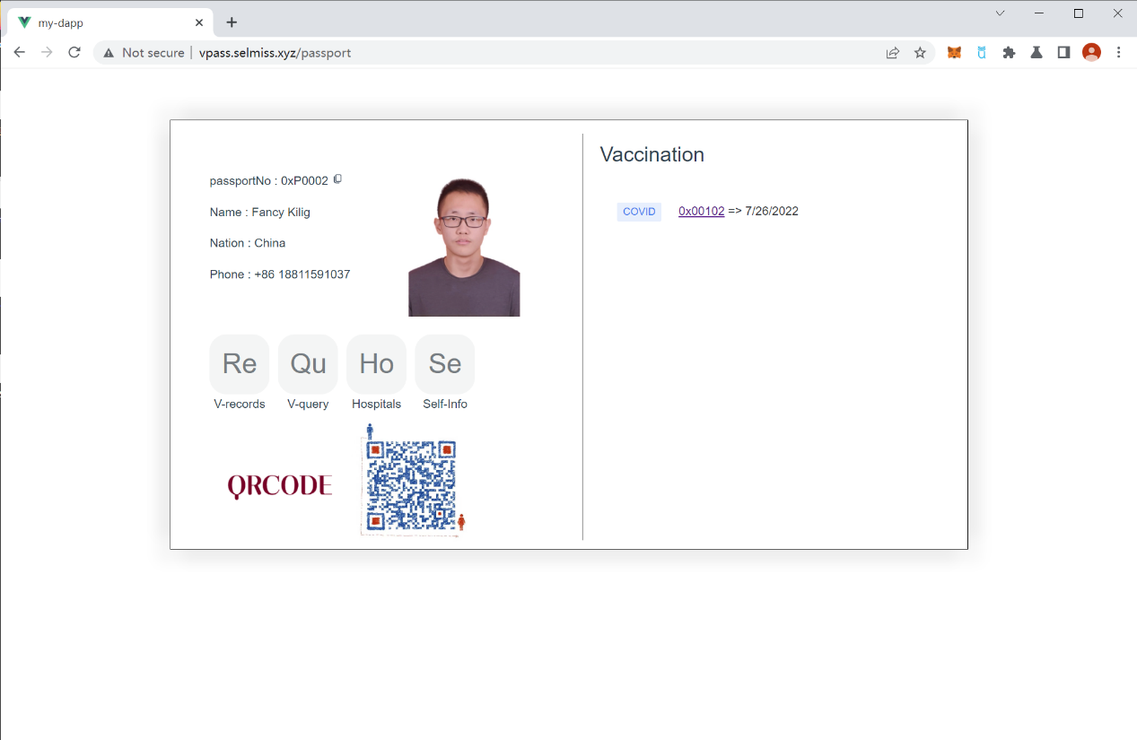
User Client
All kinds of vaccine
Vaccine records
All hospitals or CDCs
Bind passport
User’s full information

Slide 40
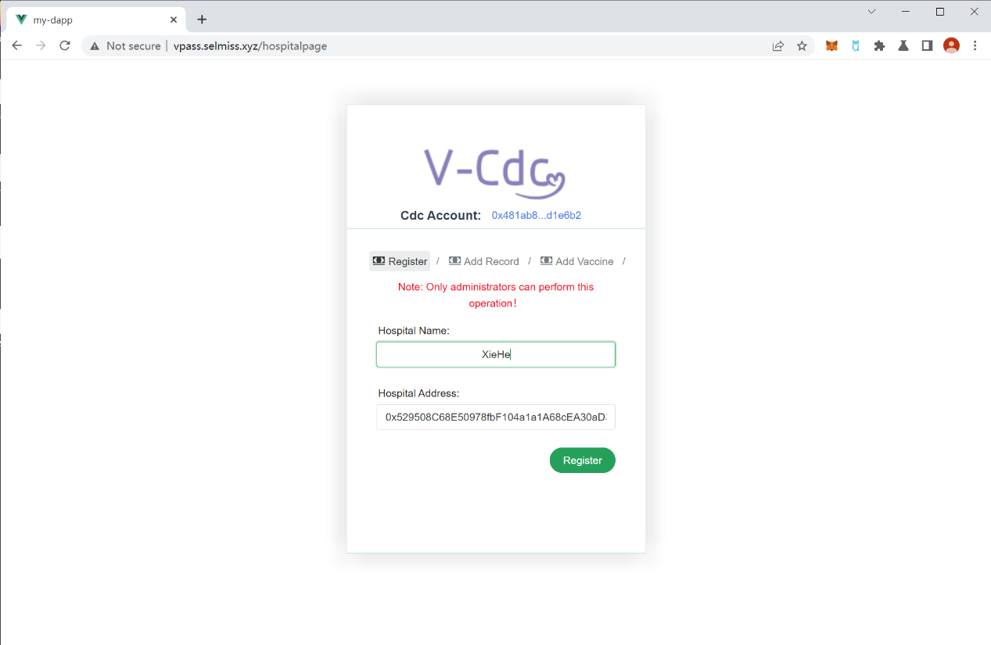
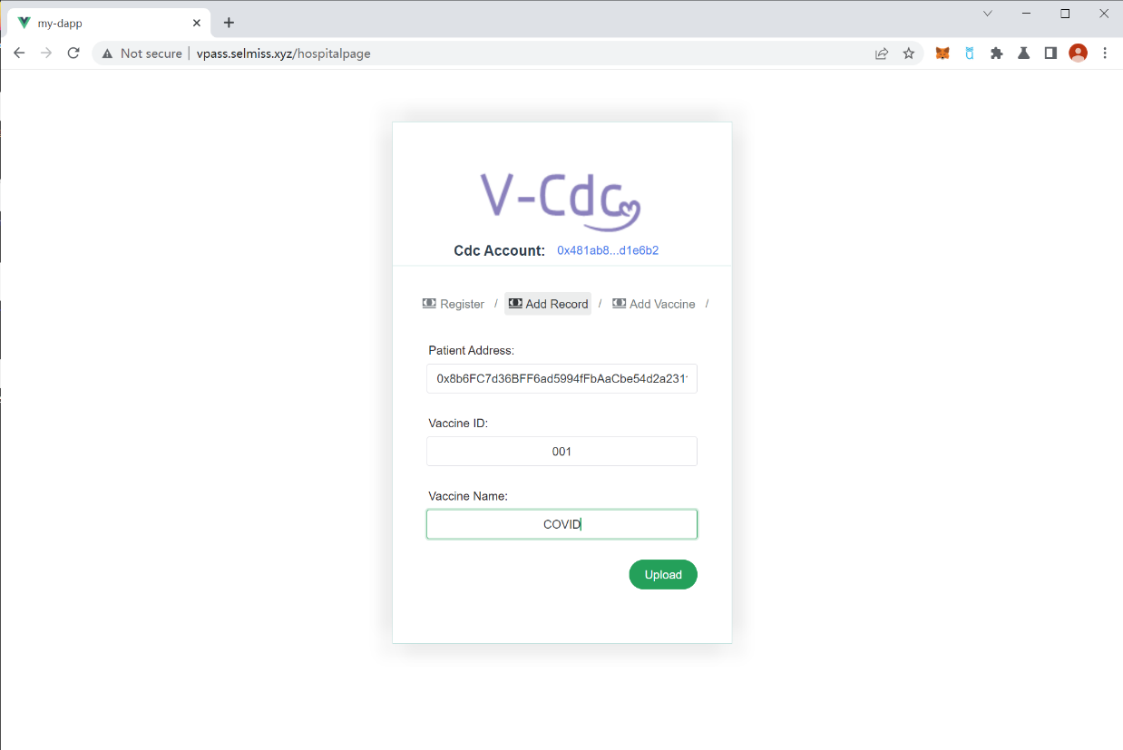
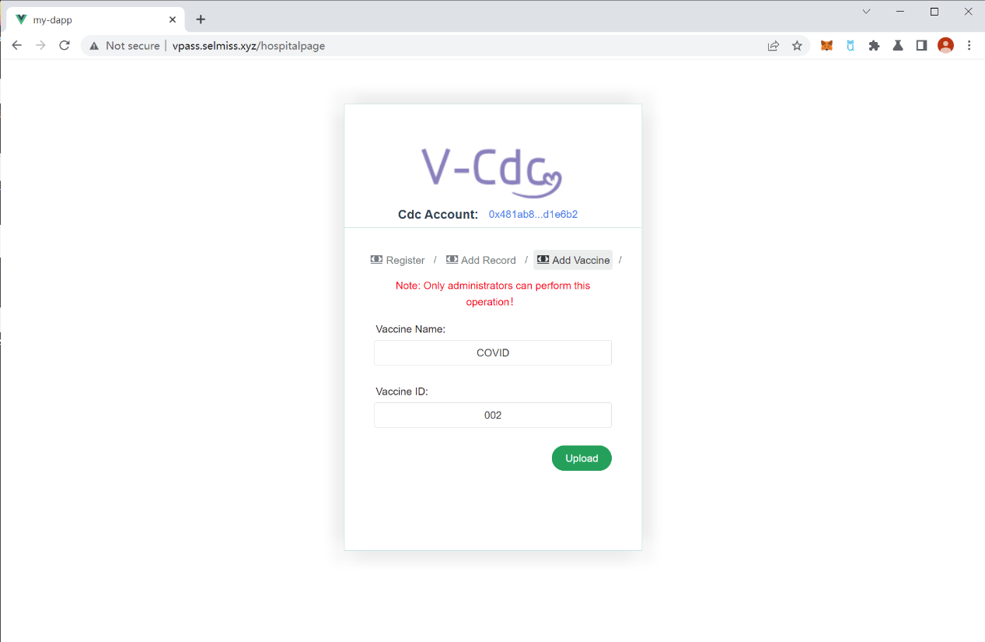
CDCs Client
Add hospitals or CDCs
(Only administrator)
Add vaccine records
(Only administrator and CDCs)
Add vaccine
(Only administrator)

Slide 41
The Future
5

Slide 42
Future of V-pass
There are several progresses we aim to realize in the future...
First, the vaccination history can be presented in the form of QR code with color(green represents qualified vaccination, red ones vice versa
Secondly, this project can also be applied to the nuclear acid test, while one was tested, the record is added to the blockchain.
Furthermore, this project has the vision and possibility to be applied to a wider medical use, such as a electronic medical record which is able to record patient’s past medical history.

Slide 43
Summary
6

Slide 44
Solution of Hard Problems
Promotion of V-pass
Easier regional consensus
The V-pass application adopts the decentralized technology of blockchain Ethereum, which enables authorized hospitals to add vaccination records and write them into the blockchain database, thereby ensuring that the added vaccination records are not modified.
Need more authoritative recognition
It is very important to get the recognition of the government, health organizations and other institutions, which can accelerate the promotion of the application.
Who will pay the gas fee
Users pay for initial identity binding
Add hospitals and vaccines, record vaccination---paid by hospitals/charge fee of users

Slide 45
Solution of Hard Problems
Permissions issues and counterfeiting
User---log in, bind passports, and query
Hospital---add new vaccines and register; add vaccination records
Privacy issues
Only the user himself can query the vaccination record and show it to others for inspection, which ensures the privacy of the user.
These are guaranteed by setting the calling permissions of individual functions

Slide 46
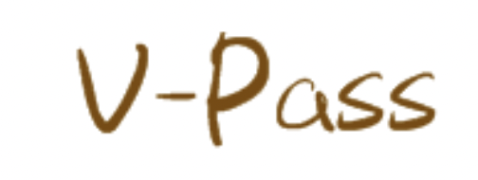

Summary - The works
In this project, under the guidance of the professor, we improved our ideas step by step, and finally formed a mature idea. We use what we learn in the course to create a decentralized app. However, this process is still full of hardships, such as how to use the PRC interface to interact with the contract, how to correctly initiate transactions, and how to make the logic self-consistent. Many times, we work until four in the morning in order to be able to successfully create the app.
Fortunately, before the deadline, we solved most of the problems, successfully created the v-pass application, and deployed it on the server.

Slide 47
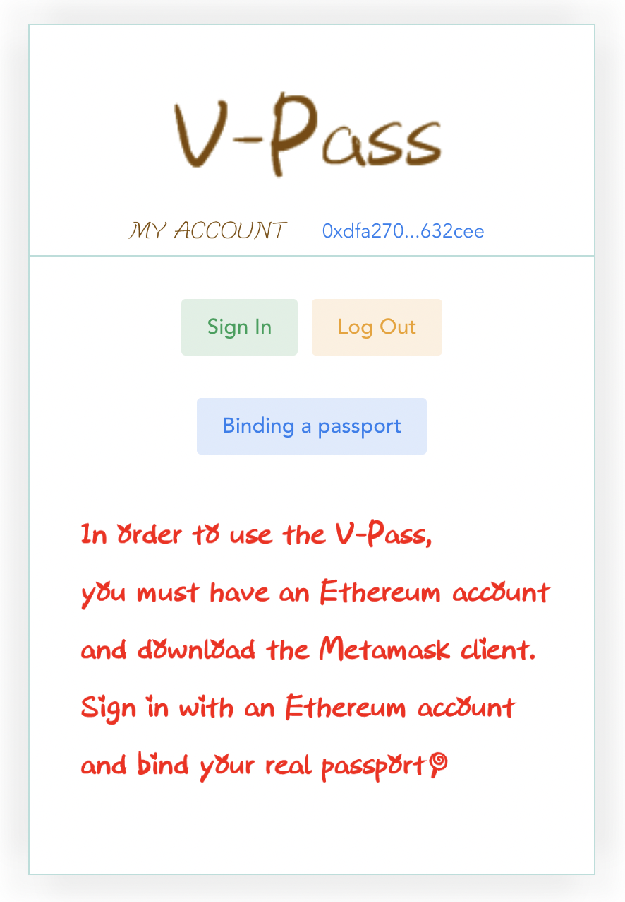
Thanks!
Hoping for advice~

